Slide 1

Macroeconomic Drivers of Stock Market Performance
Data Analytics Case Study 3
Presentation by
Abhijit Thomas- NF1032932
Sathiyabama Sampath- NF1025995
Anisha Antony- NF1022549
Resma Devi Sharma- NF1026127

Slide 2

Statement of Purpose
1.
2.
3.
Develop predictive models to analyze and forecast market behavior using macro-financial data.
Provide insights to support decisions for investors, policymakers and businesses.
Examine the impact of macroeconomic indicators on financial market performance.
Differentiate between long-term structural relationships and short-term market fluctuations.

Slide 3
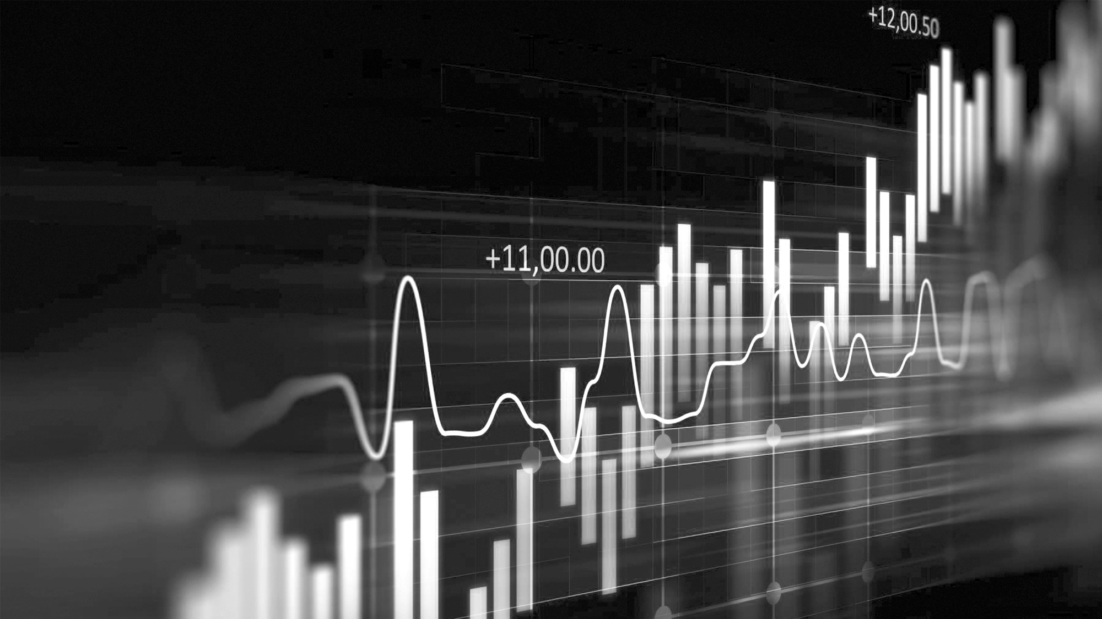
Project Objectives
Conduct data exploration to identify trends & market patterns.
Build models for Close Price, Returns, and Trading Volume.
Evaluate model performance using statistical metrics.
Perform crisis analysis focusing on 2008 financial downturn

Slide 4
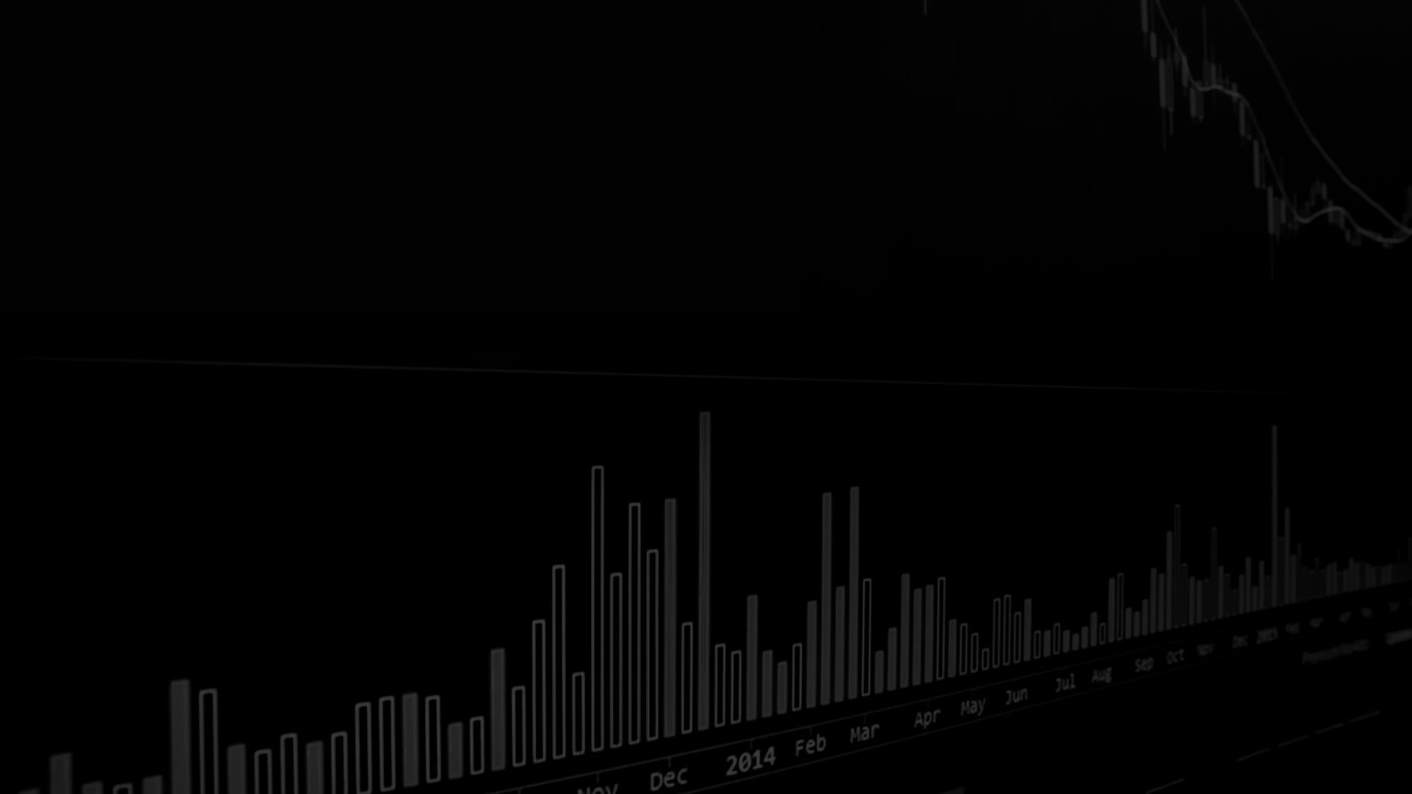
SCOPE OF THE PROJECT Dataset: 3,000 observations, 24 variables (2000–2025).
Includes stock market, macroeconomic, global, and fiscal indicators.
Combines statistical analysis with machine-learning interpretation.
Excludes high-frequency trading data and deep learning models.

Slide 5
Background Literature
GDP growth → stronger market performance over long horizons.
Corporate profits → indicator of firm health and market expansion.
Markets react to economic cycles, policy changes, and investor confidence.
Inflation & interest rates → reduce market valuations and returns.

Slide 6
Data Collection
Includes key macroeconomic indicators: GDP, Inflation, Unemployment.
Global indicators: Gold, Oil, USD/EUR, USD/JPY.
Contains daily financial data: Open, High, Low, Close, Volume.
Includes fiscal & sentiment data: Corporate Profits, Government Debt.
No missing values,
clean and consistent dataset.

Slide 7
Data Understanding
Inflation and interest rates are negatively correlated with market performance.
Gold prices tend to rise during periods of market uncertainty and risk aversion.
GDP growth is positively associated with stock market performance.
Trading volume increases significantly during periods of uncertainty or policy changes.

Slide 8

Exploratory Data Analysis
Long-term upward trend in stock prices interrupted by crisis years.
Clear cyclical patterns in GDP, inflation, and interest rates.
Strong shifts in trading volume tied to volatility periods.
Fiscal indicators move closely with economic stress (e.g., debt spikes during recessions).

Slide 9
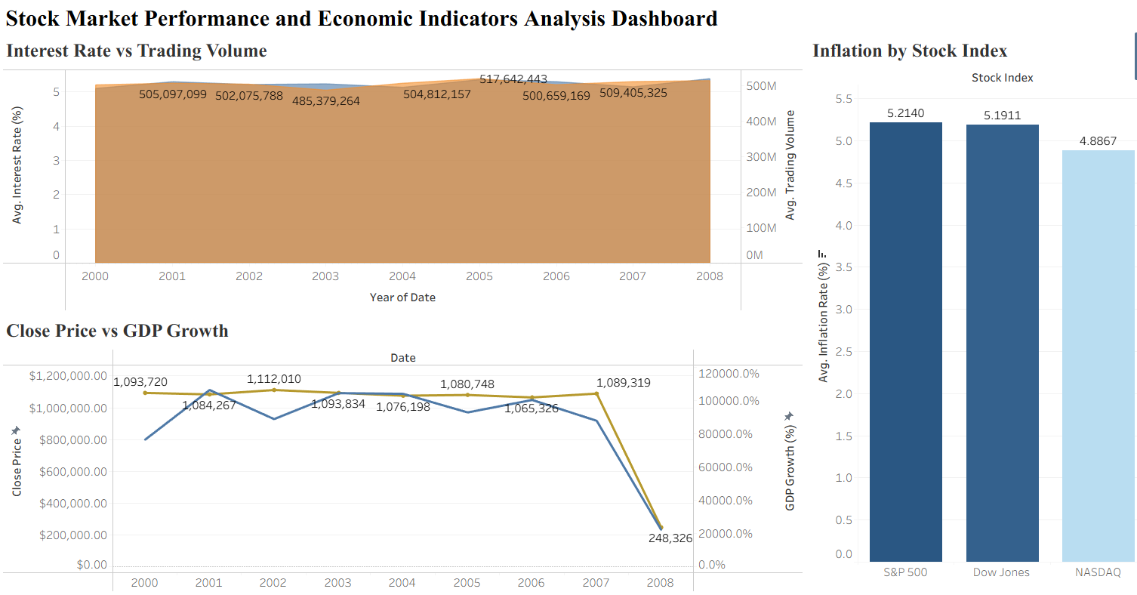
Close Price Prediction
Identifies long-run relationships influencing price levels.
Strong economic logic even with modest statistical accuracy.
Helps understand how macro shocks affect valuation trends.

Slide 10
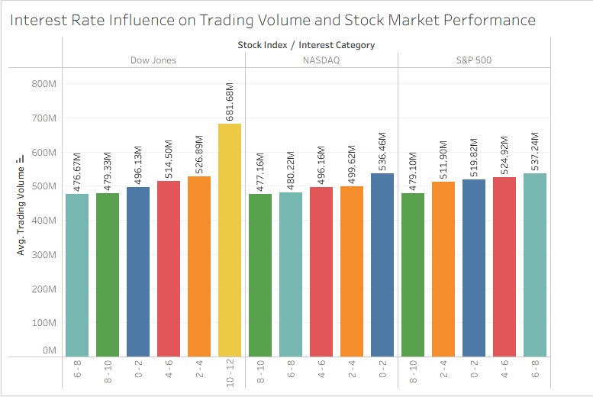
Trading Value Prediction
Trading volume indicates market liquidity and investor activity.
It is highly sensitive to interest rate changes, market volatility, and macroeconomic conditions.
It is the best-performing model among the three, effectively capturing underlying market activity patterns.

Slide 11
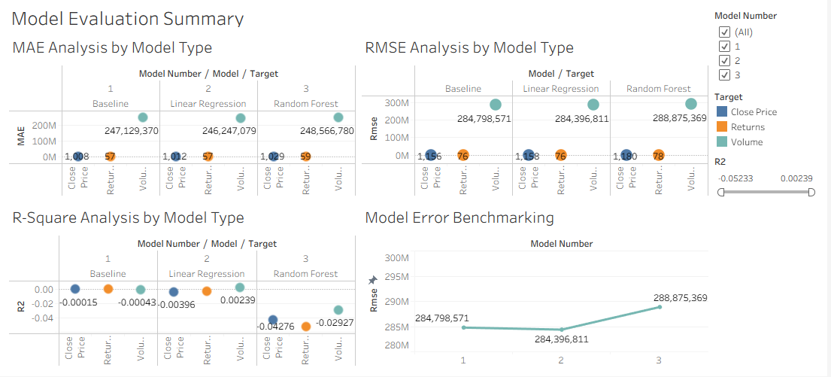
Trading Value Prediction
Close Price: Low R² — weak predictive power, influenced by external and market-specific factors.
Returns: Very low accuracy — reflects high volatility and inherent market randomness.
Volume: Relatively better performance — captures structural patterns and investor activity.
Overall: Models provide useful insights but have limited predictive capability.

Slide 12
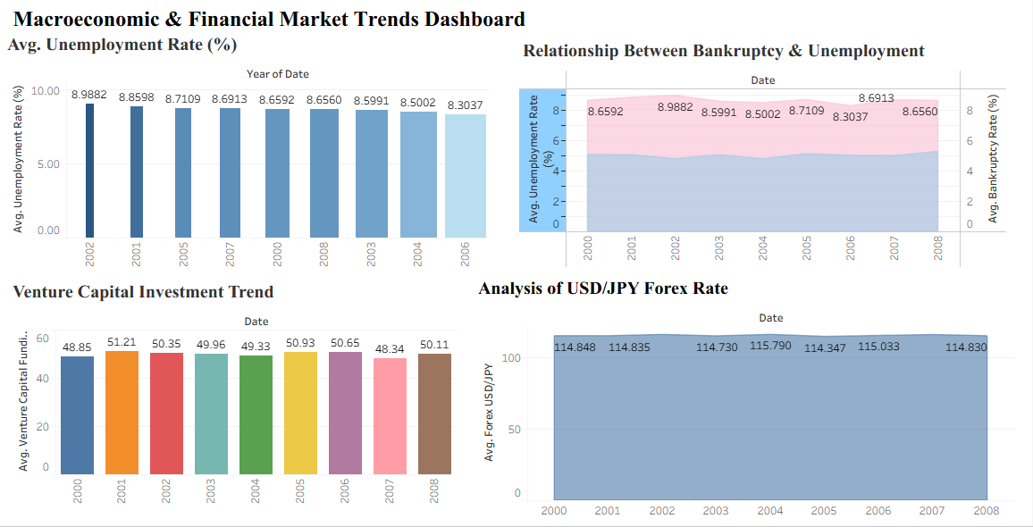
Financial crisis Analysis
Close Price: Low R² — largely affected by non-macroeconomic factors.
Returns: Very low accuracy — consistent with the inherent randomness of markets.
Volume: Stronger structural fit — reflects underlying economic activity.
Overall: Models offer insights but are not reliable for precise prediction.

Slide 13
Business Impact
Policy Makers
For Businesses
For Investors
Financial Institutions
GDP and consumer-related indicators guide production and investment decisions.
Macro indicators guide portfolio strategy and risk management.
Interest rate & fiscal decisions shape market stability.
Volume models assist with liquidity planning.

Slide 14

Conclusion
Macro variables drive long-run structural market trends.
Insights support economic planning, policy design, and investment decisions.
Short-term forecasting is limited due to market randomness.

Slide 15

Thank You

